Slide 1
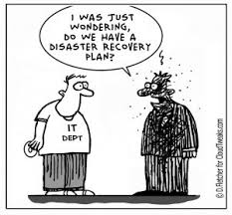
Managing Your Research Data
File Management
Based on slides by Qi Wang & Jing Su

Slide 2
Outline
Data Management Principles
Research Data Life-cycle
Data Management Checklist
Techniques to help organize your research data
File Organization
File Naming
Version Control
Metadata (ReadMe)
Running Low on Storage Space?

Slide 3
Outline
Data Management Principles
Research Data Life-cycle
Data Management Checklist
Techniques to help organize your research data
File Organization
File Naming
Version Control
Metadata (ReadMe)
Running Low on Storage Space?

Slide 4
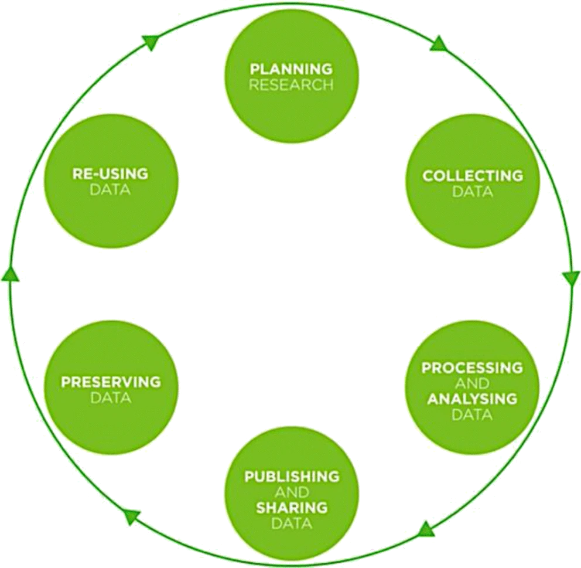
Research Data Life Cycle

Slide 5
Data Management Checklist
What types of data?
Who will be responsible to collect and document the data?
How to collect/document/store/back up/share data?

Slide 6
Data Management Checklist
What types of data?
Experimental – raw data:
Tables of figures
Images
Sequencing data
Geographical
etc.
Processed data/Analysis results
Format and size for each

Slide 7
Data Types Recommended by UK Data Archive
Type of data | Recommended formats
Quantitative tabular data with extensive metadata. Variable labels, code labels, and defined missing values | Proprietary formats of statistical packages e.g. SPSS (.sav), Stata (.dta), .sas7bdat. Delimited text and command (‘setup’) file (SPSS, Stata, SAS, etc.) containing metadata information. Some structured text or mark-up file containing metadata information, e.g. DDI XML file.
Quantitative tabular data with minimal metadata. A matrix of data with or without column | Comma-separated values (CSV) file (.csv). Tab-delimited file (.tab).
Geospatial data. Vector and raster data. | ESRI Shapefile (essential – .shp, .shx, .dbf, optional – .prj, .sbx, .sbn). Geo-referenced TIFF (.tif, .tfw). CAD data (.dwg). Tabular GIS attribute data.
Qualitative data. Textual. | eXtensible Mark-up Language (XML) text according to an appropriate Document Type Definition (DTD) (.xml). Rich Text Format (.rtf)/Plain text data, ASCII (.txt).
Digital image data. | TIFF version 6 uncompressed (.tif). Digital Imaging and Communications in Medicine (DICOM) (.dcm, .dcm30) – for CT/MRI data.
Digital audio data. | Free Lossless Audio Codec (FLAC) (.flac).
Digital video data. | MPEG-4 (.mp4). OGG video (.ogv, .ogg). motion JPEG 2000 (.mj2).
Documentation and scripts. | Rich Text Format (.rtf). PDF/A or PDF (.pdf). HTML (.html). OpenDocument Text (.odt). R Markdown files (.rmd) (with HTML version as well).
Full table at the UK Data Archive website

Slide 8
Data Types Recommended by UK Data Archive
Type of data | Recommended formats
Quantitative tabular data with extensive metadata. Variable labels, code labels, and defined missing values | Proprietary formats of statistical packages e.g. SPSS (.sav), Stata (.dta), .sas7bdat. Delimited text and command (‘setup’) file (SPSS, Stata, SAS, etc.) containing metadata information. Some structured text or mark-up file containing metadata information, e.g. DDI XML file.
Quantitative tabular data with minimal metadata. A matrix of data with or without column | Comma-separated values (CSV) file (.csv). Tab-delimited file (.tab).
Geospatial data. Vector and raster data. | ESRI Shapefile (essential – .shp, .shx, .dbf, optional – .prj, .sbx, .sbn). Geo-referenced TIFF (.tif, .tfw). CAD data (.dwg). Tabular GIS attribute data.
Qualitative data. Textual. | eXtensible Mark-up Language (XML) text according to an appropriate Document Type Definition (DTD) (.xml). Rich Text Format (.rtf)/Plain text data, ASCII (.txt).
Digital image data. | TIFF version 6 uncompressed (.tif). Digital Imaging and Communications in Medicine (DICOM) (.dcm, .dcm30) – for CT/MRI data.
Digital audio data. | Free Lossless Audio Codec (FLAC) (.flac).
Digital video data. | MPEG-4 (.mp4). OGG video (.ogv, .ogg). motion JPEG 2000 (.mj2).
Documentation and scripts. | Rich Text Format (.rtf). PDF/A or PDF (.pdf). HTML (.html). OpenDocument Text (.odt). R Markdown files (.rmd) (with HTML version as well).
Open and non-proprietry
Information loss during conversion
Full table at the UK Data Archive website

Slide 9
Data Management Checklist
What types of data?
Experimental – raw data:
Tables of figures
Images
Sequencing data
Geographical
etc.
Processed data/Analysis results
Format and size for each

Slide 10
Data Management Checklist
Who will be responsible to collect and document the data?
Roles and responsibilities
Legal and ethical obligations and right

Slide 11
Data Management Checklist
How to collect/document/store/back up/share data?
Reproducibility & re-usability
Restrictions:
Ethical obligations
Legal obligations - privacy and data processing laws
Copyright/Intellectual property

Slide 12
Data Management Checklist
How to collect/document/store/back up/share data?
Reproducibility & re-usability
Restrictions:
Ethical obligations
Legal obligations - privacy and data processing laws
Copyright/Intellectual property
Consider an Electronic Lab Notebook

Slide 13
Choosing an Electronic Lab Notebook
Cost? One-time or subscription(monthly/yearly)?
Access control. Other Users? Collaborators?
Types of information to record and storage space required
Any specialized functionality you require?
Protection for sensitive data
What happens if someone leaves the lab?
What happens when you stop using this ELN?

Slide 14
Choosing an Electronic Lab Notebook
Further Reading:
Kwok, Roberta. 2018. How to pick an electronic laboratory notebook. Nature 560 (7717): 269-270
The Electronic Lab Notebook in 2023: A comprehensive guide
Electronic Lab Notebook guide from Harvard Data Management

Slide 15
Data Management Checklist – 13 core questions
What data will you collect or create?
How will the data be collected or created?
What documentation and metadata will accompany the data?
How will you manage any ethical issues?
How will you manage copyright and Intellectual Property Rights (IPR) issues?
How will the data be stored and backed up during the research?
How will you manage access and security?
What is the long-term preservation plan for the dataset?
Which data should be retained, shared, and/or preserved?
How will you share the data?
Are any restrictions on data sharing required?
Who will be responsible for data management?
What resources will you require to deliver your plan? (people, time, hardware)
Full Checklist with guidance can be downloaded from the DCC website here

Slide 16
Outline
Data Management Principles
Research Data Life-cycle
Data Management Checklist
Techniques to help organize your research data
File Organization
File Naming
Version Control
Metadata (ReadMe)
Running Low on Storage Space?

Slide 17
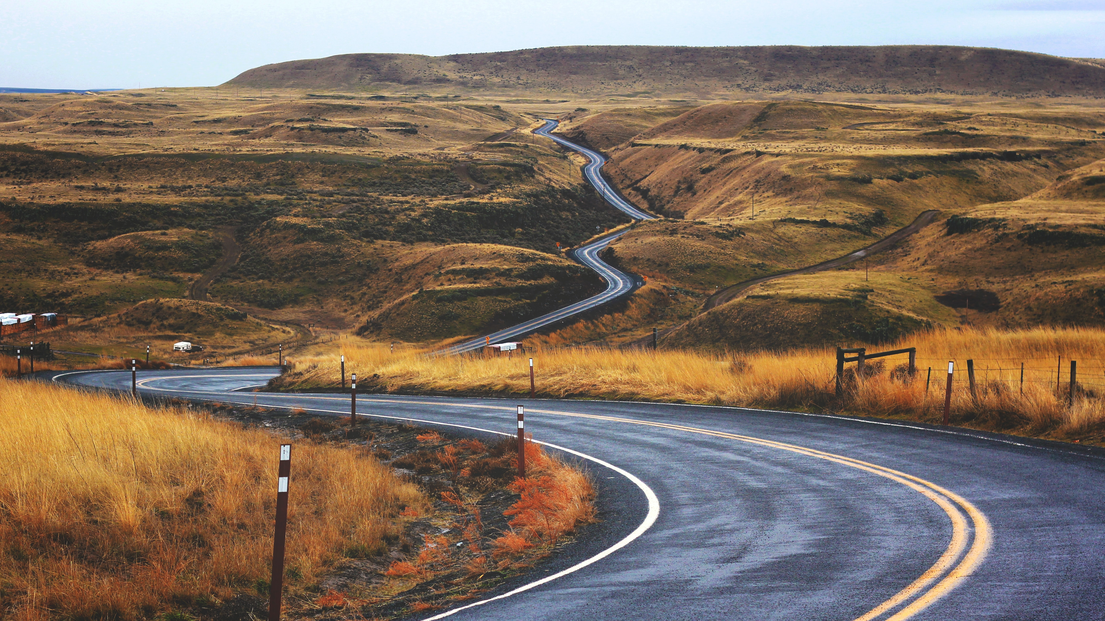
No one has
perfect data management habits,
but adopting even a few
goes a long way.

Slide 18
Outline
Data Management Principles
Research Data Life-cycle
Data Management Checklist
Techniques to help organize your research data
File Organization
File Naming
Version Control
Metadata (ReadMe)
Running Low on Storage Space?

Slide 19
File Organization
Ways to organize electronic files
Hierachical – files organized in folders and sub-folders
Tab-based – each file is assigned one or more tags

Slide 20
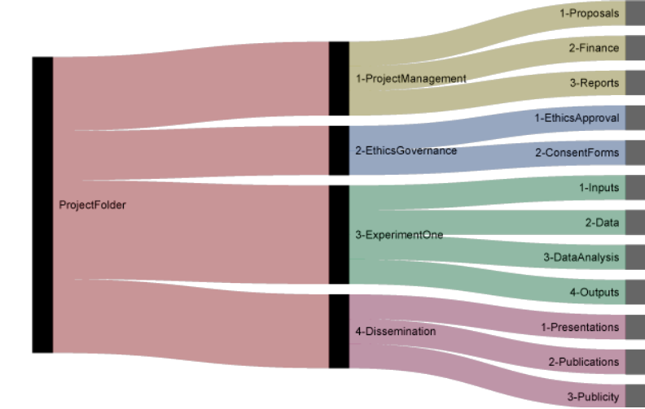
Hierachical folder structure
From: http://nikola.me/folder_structure.html

Slide 21
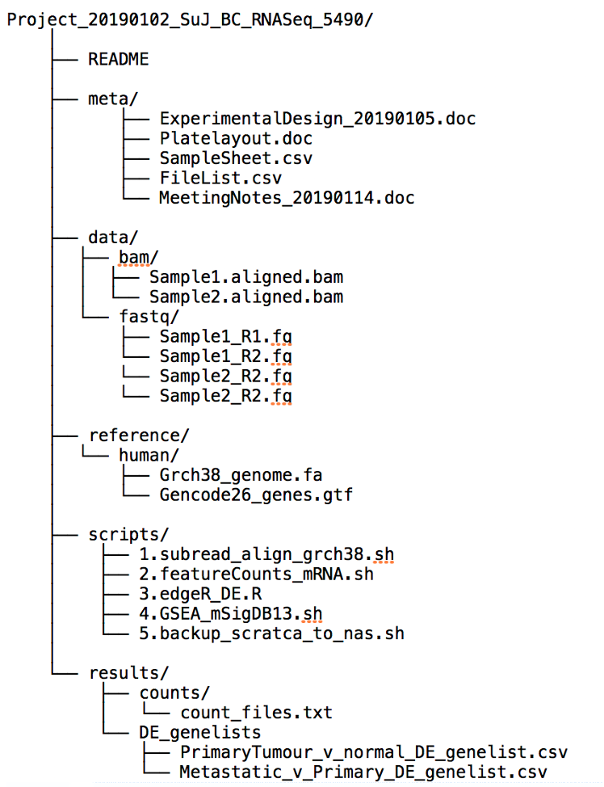
Hierachical folder structure

